Slide 1
Data cleaning
Day 1 & 2

Slide 2

Data Cleaning Goals
Identify and address systematic mistakes in the data (resulting from mistakes in
data entry program, data processing, widespread misunderstanding of the questionnaire etc)
Address missing values so they don’t unintentionally result in loss of precision or downward bias in consumption
Identify and address outliers without systematically trimming the tails of the distribution, especially gross outliers that would influence the poverty status of a hh
Ensure random errors do not have undue influence on results (through construction of key models, prices etc)

Slide 3
Systematic Mistakes – The Problem
A variety of processes (mistakes in questionnaire design, programming of data entry application, data processing, misunderstanding of the questionnaire, instrument failure) can result in systematic mistakes which mean your data is not what it should be, not what you think it is based on the questionnaire.
Do not assume your data is what it should be.
This has the potential to be hugely influential on your results.
Solution: inspect your data carefully and look carefully at the distribution of all aggregates and sub-aggregates.

Slide 4
Missing Values – The Problem
Constructing the consumption aggregate requires aggregating information from hundreds or thousands of variables across thousands of households.
Depending on how this is aggregated, missing values are either implicitly treated as zero (if using commands like collapse or egen rowtotal()) or result in a missing value for the aggregate (if using the + operator).
The first results in the total consumption being underestimated, potentially by enough to impact the poverty rate.
The second will result in the consumption aggregate not being constructed for a significant number of households.
Even worse, say the construction of sub-aggregates (like food consumption) results in a missing if any component variable is missing, but the construction of the total aggregate treats missing food consumption as 0.
Solution: be very thorough and deliberate in your treatment of missing values.

Slide 5
Outliers – The Problem
A single gross outlier (such as rice consumption being reported as 2000 kg when it is really 2000 g) can result in a household having a level of consumption above the poverty line due solely to that one mistake.
Errors of several orders of magnitude are quite possible due to sticky-0 key, mistakes over units, mistakes about recall periods, mistakes about currency conventions (amounts to be entered sometimes in Leones, sometimes in thousands of Leones).
Solution: identify and treat gross outliers.

Slide 6
Outliers – Not (Really) a Problem
Values of variables are randomly 50% higher or even twice as high as they should be.
Values at the top end of the distribution are a little suspicious although plausible for wealthy households.
There are implausible values at the bottom end of the distribution (households spending amounts less than the smallest denomination bill/coin, less than smallest quantity of the good its possible to purchase).
Although ideally we would like to identify and correct for all of these, it is very difficult (to impossible) and very time-consuming to do.
As long as these types of errors are fairly rare and fairly random, they will have basically no impact on the poverty rate.
They might impact measures of inequality like the Gini (but general household questionnaires aren’t designed to capture the consumption in the tails of the distribution anyway)
Problem: over trimming/winsorizing your data can artificially compress the distribution
Solution: do a reasonable job on moderate outliers without wasting too much time or over-trimming/winsorizing.

Slide 7
Random Errors – The Problem
A single gross outlier or a cluster of outliers could result in an erroneous construction of a key value (such as the regional price for a key staple food) or an erroneous model (such as the imputation model for the value of owner-occupied housing).
Solution: use robust constructions (median instead of mean etc) and be conservative about the observations used as input. Check the results of any constructions before applying them to the data.

Slide 8

Three Step Approach
Domain, obvious and systematic editing of each dataset that is to be used.
Comprehensive treatment of missing values and outliers
In all variables used
In all variables constructed
Check of distribution of final aggregates

Slide 9
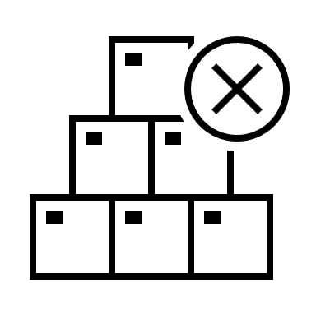
Step 1: Domain, obvious and systematic editing
Trust no one
Every time you use a dataset, inspect it carefully

Slide 10
Domain / Obvious / Systematic Errors
Check all inputs into your constructions
Check for invalid codes
Check of invalid combinations of items and units
Values that are several orders of magnitude wrong / not just improbable but impossible.
It’s improbably that anyone in our surveys would pay $10,000/month on rent. It’s impossible that they pay $10,000,000/month
Outliers and missing values scattered at random are pretty harmless.
High levels of outliers or missing, particularly if they are clustered in a specific item / area / interviewer / period can be very problematic
In future steps dealing with missing and outliers, always be on the lookout for systematic errors

Slide 11
Domain / Obvious / Systematic Errors
Only worry about extreme outliers or patterns of outliers here
Don’t change the existing data.
Identify issues that need to be investigated / addressed further
Flag observations to exclude from subsequent constructions
We will address low levels random-ish missing values and moderate outliers in a more systematic manner later

Slide 12

Step 2: Comprehensive Treatment of Missing Values and Outliers
Identify
Address

Slide 13
Flagging missing and invalid observations
Missing and invalid observations can include:
Actual missing values (when the question should have been asked)
Invalid values (such as negative values or truly impossibly large values)
Invalid zeros (the household reported spending on the item, but the expenditure amount is given as 0)
Amounts that are considered too low to be a plausible expenditure transaction for the item (e.g., it’s not possible to buy $0.05 worth of fuel)
Amounts that are not a valid currency amount for other reasons (not multiples of currency denominations in circulation)
Codes for “don’t know” or “refused” (either explicitly provided on the questionnaire, or values the interviewers likely used to indicate this such as 99 or 88)
Flag all of these observations so that we can:
Impute a reasonable value of consumption based on the median instead
Exclude them from the identification of outliers

Slide 14

Identifying Missing Data
For every component of the consumption aggregate, should there be data for this item / person / household?
Sometimes there is a filter question
Did this child go to school? If yes, how much was paid in school expenses?
Does the household own a TV? If yes, what is the current value?
Did the household purchase soap in the last month? It yes, how much was spent to buy soap?
Otherwise, the question is always asked and a 0 is recorded if nothing was spent.
How much did the household pay for water in the last month?

Slide 15
Identifying Missing Data
If the question should be answered, is it? If not, that is a missing that we will have to address.
What if the filter question is missing? Can try to impute that: do more than half of similar households report buying soap? (Define “similar” usually by geographic characteristics.)

Slide 16
Replacing Missing Values with Imputation
Easiest / most common method:
Replace with [weighted] median value of variable for the relevant group
For total household expenditures, use value per capita (or other adjustment you are using for household size)
Geographic area and urban/rural (as these reflect price levels)
Anything else relevant. For example, for school fees, level of school (primary vs. secondary) and owner (public vs. private)
Consider households interviewed around the same time if inflation / seasonal price variations are a concern
More sophisticated methods are available, see M&V 7.2/7.3 for discussion and references

Slide 17

Excessive Missing Values
If too many items are missing for a household, may just want to drop the household from the analysis of poverty and adjust the weights considering this household as a non-response
Rule of thumb used for Sierra Leone: drop households missing more than ~ 10% of data from any section

Slide 18
What is an Outlier?
Not all outliers are errors. Not all errors are outliers.
What we want to find and adjust for are errors, looking at outliers is one tool
“An outlying observation, or ‘outlier,’ is one that appears to deviate markedly from other members of the sample in which it occurs.” (Grubbs 1969)
An outlier is not the same as the tail of the distribution. Every distribution has a tail.
Avoid any rule that would always flag some observations as “outliers” even if the data was perfectly correct
Using too low a Z-score cut-off (consider expected number of observations with a given Z-score for your sample size)
Using any percentile cut-off
If a variable is known to have a normal distribution, for any given sample size you can estimate how many observations you expect to have (say) more than 3 standard deviations from the mean.
Notes:
Grubbs quoted in M&V p 146

Slide 19
Detection of Outliers
Done on variable for expenditure / use value / value of consumption by item
We generally assume per capita consumption / expenditure of each item is log-normally distributed
Often done separately for subgroups of households by location or month of survey.
Do not make these groups too small.
Do not subdivide unless there is good evidence that expenditure patterns are different.
Often, urban/rural is sufficient.

Slide 20
Formulas to Identify Outliers
Identify location (central tendency) of the distribution, a scale to measure distance from that center and set a threshold (maximum allowed distance)
Location: mean (sometimes after trimming top and bottom of distribution) or median
Scale: standard deviation, mean absolute deviation (MADS) from the median (less influenced by extreme values), interquartile range etc
Threshold: can be set at values corresponding to a Z-score of 2.5, 3, 3.5 etc. (Recommend at least 3.)

Slide 21
Examples of Formulas to Identify Outliers
Classic Z-score: uses mean as location, standard deviation as scale. Distance from center is expressed as Z-score, so threshold is expressed as a Z-score of ±3 etc.
Concerns: estimation of mean and standard deviation are easily biased by the presence of extreme values
Robust Z-score (as described by M&V): uses median as location and MADS as scale. Using Z = (X – med(X))/(mads(x)/0.675) gives something equivalent to Z-score in that, if X is normal, same percent of distribution has Z-score < 3.

Slide 22
Examples of Formulas to Identify Outliers
Tukey: Usually expressed as [Q1 – n * IQR, Q3 + n * IQR] where n = 1.5 to 2.5. Uses median as location (assuming symmetric distribution), IQR as scale. Z = (X – med(X))/(iqr(x)/1.35) is equivalent.
Alternative: Drop top and bottom 5% of distribution and take mean as location. IQR as scale.
All of these are fine and basically equivalent.

Slide 23
Lower Outliers
Includes inappropriate values of 0 (household reports consuming but 0 for amount spent)
Often best analyzed based on total household consumption (as opposed to per capita/per adult equivalent for upper outliers)
Consider smallest possible quantum that can be purchased
How much for one book of matches? One cup of rice?
What is the smallest unit of currency in circulation?
Very often just use smallest currency denomination
Notes:
Note some expenditure variables may legitimately be zero, for example amount spent on water if no filter question (do you pay anything for water?) is used.

Slide 24
Treatment of Outliers Believed to be Errors
Options
Consider them as missing and replace with imputed value – see discussion above on missing at random
Winsorize – replace with largest (smallest) non-outlier value.
Assumption is that household did purchase an unusually large amount, just not as much as recorded.
Or, more pragmatically, splitting the difference between believing the recorded value and not
If analysis is done on per capita basis, make sure to multiply back by household size

Slide 25
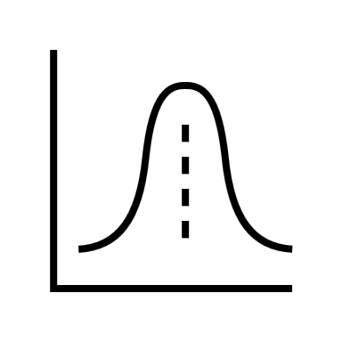
Overall Distribution of Consumption
Check the overall distribution of consumption
Should be roughly log-normal

Slide 26
Checking Overall Distribution
Check each component of the consumption aggregate as you construct it, both in total and per capita terms
Check the distribution of total food consumption and total non-food consumption
Any marked deviation from a log-normal distribution is cause for concern and should be investigated
Decompose by type of consumption: food into starches, meat, fruits/vegetables etc.
Decompose by type of household: farmer vs. not, renters vs. owners
Check distribution of final welfare measure

Slide 27
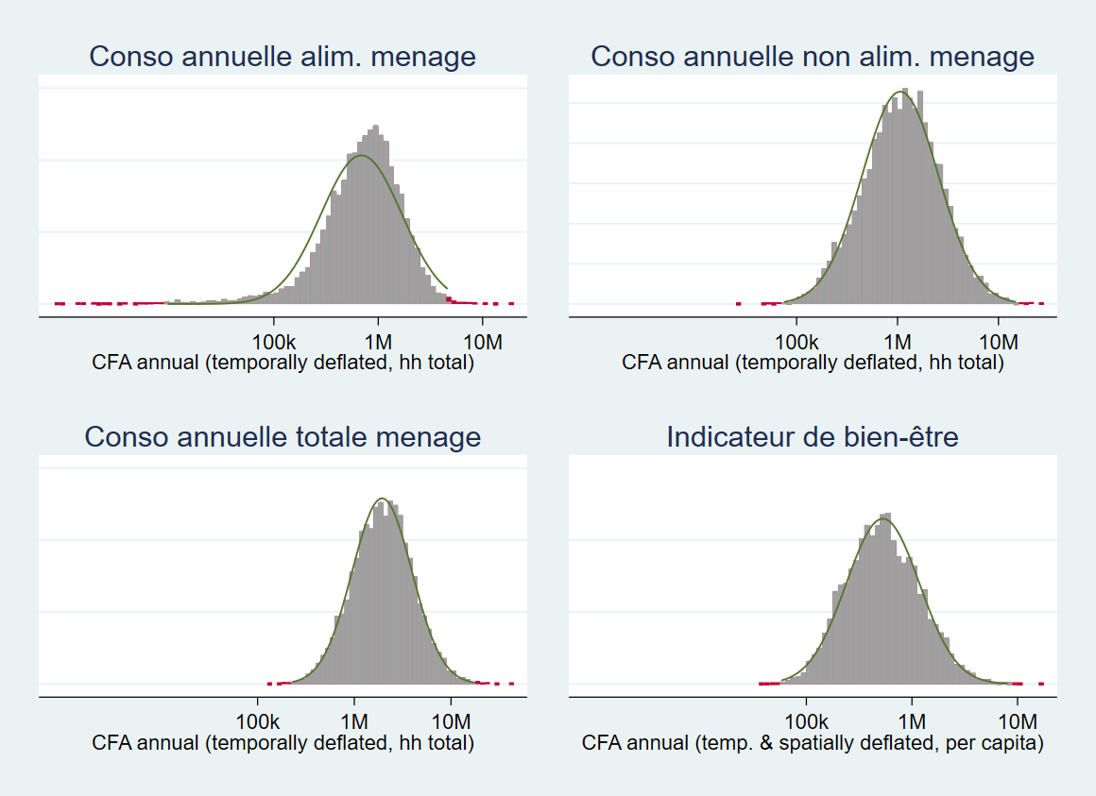
Use of outdetect
Stata command written by M&V & coauthors
Not robust enough / too slow to use in loop on every single item
Very nice for looking at distribution of final aggregates

Slide 28
flagout example for outliers and imputation
Consider expenditure data on general nonfood items
b0 is item code
b2 is amount spent in last month
missing and invalid values in b2 have already been identified and flagged via the variable miss_inv
assume per capita expenditure is log-normally distributed
gen consexp = b2 if !miss_inv
gen lpccons = log(consexp/hhsize)
gen adm1ur = admin1 * 10 + urbrur
flagout lpccons [pw = hhweight], item(b0) z(3.5) over(admin1 urbrur adm1ur)
replace consexp = hhsize * exp(_max) if _flag == 1
// replace consexp = hhsize * exp(_min) if _flag == -1
replace consexp = hhsize * exp(_med) if miss_inv
Winsorize upper outliers
Winsorize lower outliers
Impute missing values

Slide 29
flagout syntax
syntax varname [pweight] [if], item(varlist max=1) [over(varlist) minn(integer 30) z(real 3.5)]
varname : variable whose distribution is to be analyzed, assumed to be normally distributed
transform variable (make per capita, take logs) before passing to program
Sampling weights are allowed (and recommended to be used [currently required])
Distribution of values of varlist for each value of item are assumed independent.
required, so construct constant variable if needed
Over allows ordered set of variables to define subgroups
the last variable in the list with min number of obs will be used to define the location and scale
minn sets the minimum number of observations required; 30 is the recommended default
z specifies the Z-score beyond which observations are considered to be outliers and flagged

Slide 30
flagout details
Uses median as center of distribution
Uses interquartile range (p75 – p25) as scale if this is non-zero, otherwise p90 – 10
these are rescaled to make the Z-score thus constructed equivalent to the standard Z-score (constructed with the standard deviation) on a normal distribution
if p10 = p90 (that is, at least 80% of the observations take the same value), any observation not equal to this value will be flagged as an outlier
Constructs four variables:
_flag indicates if an observation is identified as a lower outlier (-1), upper outlier (1) or nonoutlier (0)
_min is the lower limit of non-outliers
_max is the upper limit of non-outliers
_med is the median
Each is defined over the relevant subgroup (last over variable with at least minn observations)

Slide 31
Data clean – step1
Variable names
Keep the original name or change to a new one
Labels
Variable label: Make sure all the variables have a valid description.
Make sure all the value labels are correctly defined
Yes: 1 No: 0
Urban: 1 Rural: 2
Duplicates check
Real duplicates
Enter error
Keep or drop
Missing check

Slide 32
Flagging missing and invalid observations
Consider expenditure data on general nonfood items
b2 is amount spent in last month
lab def causes 0 "no problem" 1 "missing" 2 "negative" 3 "zero" 4 "too small" 5 "not round number" 6 "special code"
gen miss_inv = 0
replace miss_inv = 1 if b2 >= .
replace miss_inv = 2 if b2 < 0
replace miss_inv = 3 if b2 == 0
replace miss_inv = 4 if b2 > 0 & b2 < 50 // some threshold for smallest plausible transaction, can be item-dependent
replace miss_inv = 5 if mod(b2, 5) != 0
replace miss_inv = 6 if inlist(b2, $specials)

Slide 33
Data clean – step2
Validate the skipping pattern
Some questions will be omitted for some households or individuals if a specific condition is met.
eg. if “others” are selected, the following question will be asked to specify
Validate the data
Checking missing
categorical variables: if the value within the range
String variables: if all the input meaningful. Especially for “others”

Slide 34
Data clean – step3
Issue fix
Some common problems:
Wrong unit entered. 2,000g instead of 2,000kg
Missing decimals: 200000 instead of 2000.00
Currency issues
Hard code
Use it when necessary
We should try not to change the value directly to avoid manipulation
Some outliers could be fixed by reviewing the data by the statistical team.

Slide 35
Other extra topics

Slide 36
Household Weight
When to use household weight
Use it when the statistic you want describes households as units.
Examples:
% of households with electricity
Average household expenditure
Distribution of household sizes
Ownership of durable goods at the household level (e.g., % of households owning a car)
Here, each household counts once, regardless of how many people live in it.
​

Slide 37
Individual Weight
When to use population (individual) weight
Use it when the statistic you want describes individuals (people), or when the measure is per capita.
Examples:
Poverty headcount rate (% of people living below $2.15/day)
Literacy rate of adults
Labor force participation rate
Average consumption per person
Demographic breakdown (age, sex, etc.)
Here, households with more members contribute more because they represent more people in the population.

Slide 38
weight comparison
The intuition:
Household weights → “Each household represents many similar households.”
Population weights → “Each person represents many similar people.”
Since households vary in size, the two weights give different results if you mix them up.
For example:
If you estimate poverty with household weights, you’d get the share of households that are poor.
If you use population weights, you get the share of people who are poor (this is the standard poverty rate)
Rule of thumb
Unit = household → use weight_hh
​Unit = individual or per capita → use weight_pop ​

Slide 39
Extra data needed
Conversion factor:
Change form the not standard unit(heap, tin, etc.) to standard unit (kg/l)
Market unit price for food
Ex: Average price for rice in kg
Enegy intake convertion factor
Food energy for per 100g items

